Slide 1
CSC 735 – Data Analytics
Chapter 3
A Tour of Spark’s Toolset

Slide 2
Spark’s Toolset

Slide 3
Datasets: Type-Safe Structured APIs
Structured data type
Type-safe
With DataSet, you write a case class that specifies the structure of the DS
Each record in the DS follows the type of the class
DataSet API cannot be used with Python or R

Slide 4
Datasets (cont.)
You can load data as a DS, convert it to DF as needed, back to DS, and use SQL as needed
When you collect a DS, you will get objects of the proper type of the Dataset (case class)
This makes it easy to perform manipulation in a distributed and a local manner without much code changes

Slide 5
Datasets (cont.)
case class Flight(DEST_COUNTRY_NAME: String,
ORIGIN_COUNTRY_NAME: String, count: BigInt)
val flightsDF = spark.read
.parquet("/data/flight-data/parquet/2010-summary.parquet/")
val flights = flightsDF.as[Flight]
flights.filter(flight_row => flight_row.ORIGIN_COUNTRY_NAME != "Canada") .map(flight_row => flight_row).take(5)
flights.take(5).filter(flight_row => flight_row.ORIGIN_COUNTRY_NAME != "Canada")
.map(fr => Flight(fr.DEST_COUNTRY_NAME, fr.ORIGIN_COUNTRY_NAME, fr.count + 5))

Slide 6
Parquet File Format
Parquet is a columnar storage format
An efficient format for data analytics
It support complex nested data structures
Parquet uses a three-level hierarchical structure for storing data in a file
A file consists of row groups, which contain column chunks, which contain one or more pages
Parquet supports a variety of data encodings and compression techniques
It also allows compression to be specified on a per-column basis

Slide 7
Batch vs Streaming Applications
Batch processing:
data is collected for a period of time and processed in batches
data processing can range from minutes to days
high latency: wait time to see results can be long
Stream processing:
data is generated continuously
data processing is continuous and long running
data needs to be processed and analyzed as it is collected

Slide 8
Streaming Applications
Fraud detection in an e-commerce system
Network intrusion or security breach detection
Application or device failure detection in a data center
A stock trading application that displays the top 10 most actively traded stocks
Monitoring the health of heavy volume online services

Slide 9
Structured Streaming
Structured Streaming is a high-level API for stream processing that became production-ready in Spark 2.2
It makes writing streaming applications easy because the code for a Structured Streaming Application can be based on what you wrote for batch processing , you can take the same operations that you perform in batch mode using Spark’s structured APIs and run them in a streaming fashion

Slide 10
Structured Streaming
Retail dataset
Each file represents a day of data
Simulate data being produced continuously by retail stores and sent to a location where they will be processed by a streaming application
Sample of the data
InvoiceNo | StockCode | Description | Quantity | InvoiceDate | UnitPrice | CustomerID | Country
536365 | 85123A | WHITE HANGING HEART T-LIGHT HOLDER | 6 | 12/1/2010 8:26 | 2.55 | 17850 | United Kingdom
536365 | 71053 | WHITE METAL LANTERN | 6 | 12/1/2010 8:26 | 3.39 | 17850 | United Kingdom
536365 | 84406B | CREAM CUPID HEARTS COAT HANGER | 8 | 12/1/2010 8:26 | 2.75 | 17850 | United Kingdom
536365 | 84029G | KNITTED UNION FLAG HOT WATER BOTTLE | 6 | 12/1/2010 8:26 | 3.39 | 17850 | United Kingdom

Slide 11
Analyze as a Static Dataset
Read as a DataFrame and get the schema
val staticDataFrame = spark.read.format("csv")
.option("header", "true")
.option("inferSchema", "true")
.load("/data/retail-data/by-day/*.csv")
staticDataFrame.createOrReplaceTempView("retail_data")
val staticSchema = staticDataFrame.schema

Slide 12
Analyze as a Static Dataset (cont.)
Let us find the total amount spent per customer per day
Quantity | InvoiceDate | UnitPrice | CustomerID
6 | 12/1/2010 8:26 | 2.55 | 17850
import org.apache.spark.sql.functions.{window, column, desc, col}
staticDataFrame
.selectExpr(
"CustomerId",
"(UnitPrice * Quantity) as total_cost",
"InvoiceDate")
.groupBy(
col("CustomerId"), window(col("InvoiceDate"), "1 day"))
.sum("total_cost")
.show(5)

Slide 13
Analyze as a Static Dataset (cont.)
+----------+-----------------------+-----------------------+
|CustomerId| window | sum(total_cost)|
+----------+-----------------------+-----------------------+
| 16057.0|[2011-12-05 00:00...| -37.6|
| 14126.0|[2011-11-29 00:00...|643.6300000000001|
| 13500.0|[2011-11-16 00:00...|497.9700000000001|
| 17160.0|[2011-11-08 00:00...|516.8499999999999|
| 15608.0|[2011-11-11 00:00...| 122.4|
+----------+------------------------+-----------------------+

Slide 14
The Streaming Code
No trigger mode is specified
val streamingDataFrame = spark.readStream
.schema(staticSchema)
.option("maxFilesPerTrigger", 1)
.format("csv")
.option("header", "true")
.load("/data/retail-data/by-day/*.csv")

Slide 15
Checking if the Data is Streaming
streamingDataFrame.isStreaming //res15: Boolean = true

Slide 16
Analyze Streaming Data
Let’s set up the same business logic as the static DataFrame manipulation
val purchaseByCustomerPerDay = streamingDataFrame
.selectExpr(
"CustomerId",
"(UnitPrice * Quantity) as total_cost",
"InvoiceDate")
.groupBy(
$"CustomerId", window($"InvoiceDate", "1 day"))
.sum("total_cost")

Slide 17
Analyze the Streaming Data (cont.)
Previous operations are lazy
We have to call a streaming action to start the execution of this data flow
The action will output to an in-memory table
Spark update the table after each trigger

Slide 18
Analyze the Streaming Data (cont.)
purchaseByCustomerPerDay.writeStream
.format("memory") // memory = store in-memory table
.queryName("customer_purchases") // the name of the in-memory table
.outputMode("complete") // we want to see all the records in the table
.start()

Slide 19
Querying the Streaming Data
spark.sql("""
SELECT *
FROM customer_purchases
ORDER BY `sum(total_cost)` DESC
""")
.show(5)

Slide 20
Writing the Table to Console
Just set format to console
purchaseByCustomerPerDay.writeStream
.format("console")
.queryName("customer_purchases_2")
.outputMode("complete")
.start()

Slide 21
Machine Learning and Advanced Analytics
Spark provides a built-in library/API for large-scale machine learning (ML)
API has methods for data preprocessing as well as different kinds of ML tasks including regression, classification and clustering
Data munging (aka data wrangling) means transforming the raw data to a form that is appropriate for a ML algorithm
We’ll look at an example that uses the k-means algorithm to cluster the retail data

Slide 22
ML Pipeline
A ML application consists of a sequence of steps
Spark’s ML API provides a set of abstractions that correspond to the main ML steps
Inputs and output are mostly DataFrames
Similarity between ML main steps and MLlib pipeline main concepts

Slide 23
Preprocessing the Data
MLlib requires the data to be numerical
The retail dataset contains different types of data
Transformers allow us to preprocess the data
staticDataFrame.printSchema()
root
|-- InvoiceNo: string (nullable = true)
|-- StockCode: string (nullable = true)
|-- Description: string (nullable = true)
|-- Quantity: integer (nullable = true)
|-- InvoiceDate: timestamp (nullable = true)
|-- UnitPrice: double (nullable = true)
|-- CustomerID: double (nullable = true)
|-- Country: string (nullable = true)

Slide 24
Preprocessing the Data
Replace all null values in numeric columns by 0
Add a new column
Then, use coalesce(5) to combine and reduce partitions to 5
Reducing number of partitions reduces parallelism but is useful when you have partitions with few elements
coalesce(5) does not perform a full shuffle
import org.apache.spark.sql.functions.date_format
val preppedDataFrame = staticDataFrame
.na.fill(0)
.withColumn("day_of_week", date_format($"InvoiceDate", "EEEE"))
.coalesce(5)

Slide 25
Splitting the Data
The dataset needs to be split into a training dataset and testing dataset
val trainDataFrame = preppedDataFrame .where("InvoiceDate < '2011-07-01'")
val testDataFrame = preppedDataFrame .where("InvoiceDate >= '2011-07-01'")
trainDataFrame.count() //245903
testDataFrame.count() //296006

Slide 26
Transformers
Spark provides transformers to help preprocess data
Transformers transform data in a DataFrame by manipulating one or more columns during the feature engineering step
They allow us to add columns (features), convert column values from text to numerical values, and normalizing values

Slide 27
Transformers (cont)
A transformer transforms data in an input column, and stores the result in an output column
The input column and output column names can be specified during the construction of a transformer
If they are not specified, the default column names ("inputCol", "outputCol") will be used

Slide 28
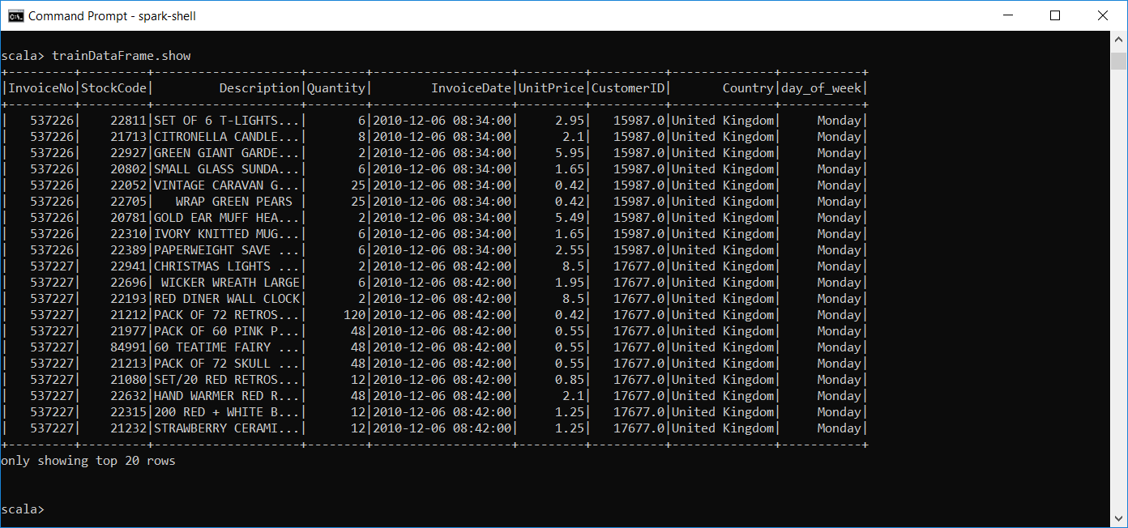
Preprocessing the Data
We need to convert day_of_week to numerical values

Slide 29
StringIndexer
It converts string values into numerical values
Most frequent value is encoded 0, second most frequent as 1, …etc.
import org.apache.spark.ml.feature.StringIndexer
val indexer = new StringIndexer()
.setInputCol("day_of_week")
.setOutputCol("day_of_week_index")

Slide 30
OneHotEncoder
Result of StringIndexer is ordinal values (0, 1, …etc.) that suggest an order
Monday could be encoded as 2 and Sunday as 5, which may suggest that Sunday is greater than Monday, which is incorrect
To fix this, we use OneHotEncoder, which maps ordinal values into a binary vector and flags the current value
import org.apache.spark.ml.feature.OneHotEncoder
val encoder = new OneHotEncoder()
.setInputCol("day_of_week_index")
.setOutputCol("day_of_week_encoded")

Slide 31
VectorAssembler
It combines a set of individual columns into a vector column (or matrix, or 2D array).
In ML, this is equivalent to combining individual features into a dataset over all the features
Each input column must be of type: numeric, Boolean, or vector
The output vector column contains the values of all the columns in the specified order
All ML algorithms in Spark take as input a vector type

Slide 32
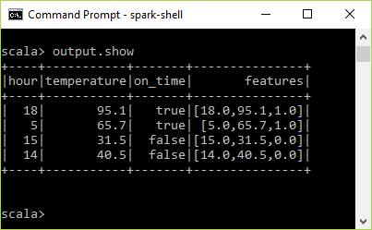
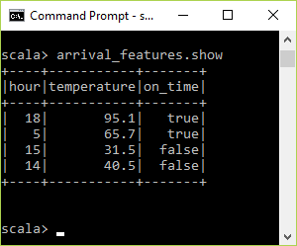
VectorAssembler - Example
import org.apache.spark.ml.feature.VectorAssembler
val arrival_features = spark.createDataFrame( Seq((18, 95.1, true), (5, 65.7, true), (15, 31.5, false), (14, 40.5, false) )) .toDF("hour", "temperature", "on_time")
val assembler = new VectorAssembler() .setInputCols(Array("hour", "temperature", "on_time")) .setOutputCol("features")
val output = assembler.transform(arrival_features)
output.show

Slide 33
Preprocessing the Data - VectorAssembler
import org.apache.spark.ml.feature.VectorAssembler
val vectorAssembler = new VectorAssembler()
.setInputCols(Array("UnitPrice", "Quantity", "day_of_week_encoded"))
.setOutputCol("features")

Slide 34
Estimators
An estimator is one of two things
A ML algorithm that we can train/fit on data to get a model
Example: LinearRegression
A kind of transformer that we can fit on some data
Example: StringIndexer
It requires two passes over the data: first pass to find the frequencies. Second pass to do the encoding

Slide 35
Estimators (cont.)
An estimator has a function called fit that applies an algorithm on the input column of a DF
The result is encapsulated in an object called Model, that represents a ML algorithm and is a Transformer

Slide 36
Pipelining the Workflow
A pipeline allows you to set up a dataflow of the relevant transformations that data will go through
Any data that we need to transform can go through the same exact process
import org.apache.spark.ml.Pipeline
val transformationPipeline = new Pipeline()
.setStages(Array(indexer, encoder, vectorAssembler))

Slide 37
Preparing for Training
Preparing for training is a two-step process
First, call the Pipeline’s fit() method
This calls the transform() method of each Transformer and fit() method of each Estimator in the Pipeline
val fittedPipeline = transformationPipeline.fit(trainDataFrame)

Slide 38
Preparing for Training (cont.)
Second, call the fitted Pipeline’s transform() method on the training dataset
val transformedTraining = fittedPipeline.transform(trainDataFrame)

Slide 39
Caching
Caching is an optimization techniques that allows us to store a copy of a transformed dataset in memory
Now, we can access it faster
transformedTraining.cache()

Slide 40
Training the Model
First, import the model and instantiate it
import org.apache.spark.ml.clustering.Kmeans
val kmeans = new KMeans()
.setK(20)
.setSeed(1L)

Slide 41
Training the Model (cont.)
Second, train the model on the dataset by calling its fit method
We can also use the trained model to cluster the test dataset
val kmModel = kmeans.fit(transformedTraining)
val transformedTest = fittedPipeline.transform(testDataFrame)

Slide 42
Model Evaluation
The method computeCost returns the sum of the squared distances of the samples from their nearest cluster centers
You can print the clusters’ centers
kmModel.computeCost(transformedTraining)
//res23: Double = 8.455373996537484E7
println("Cluster Centers: ")
kmModel.clusterCenters.foreach(println)

Slide 43
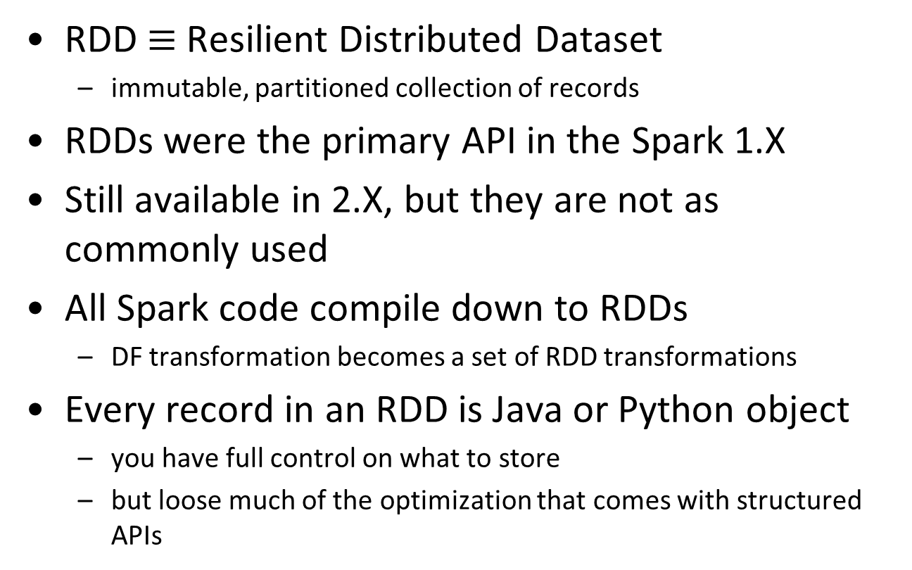
Low Level APIs (RDDs) – Chapter 12
RDD $≡$ Resilient Distributed Dataset
immutable, partitioned collection of records
RDDs were the primary API in the Spark 1.X
Still available in 2.X, but they are not as commonly used
All Spark code compile down to RDDs
DF transformation becomes a set of RDD transformations
Every record in an RDD is Java or Python object
you have full control on what to store
but loose much of the optimization that comes with structured APIs

Slide 44
Creating An RDD
There are three ways to create an RDD:
Parallelizing an object collection
Reading data from storage
Applying a transformation

Slide 45
Creating An RDD by Parallelizing a Collection
Parallelize a collection means converting it to a distributed dataset that can be operated on in parallel
This is done by calling the parallelize() method of SparkContext
val myCollection = "Spark The Definitive Guide : Big Data Processing Made Simple".split(" ")
//myCollection: Array[String] = Array(Spark, The, Definitive, Guide, :, Big, Data, Processing, Made, Simple)
val words = spark.sparkContext.parallelize(myCollection, 5)
//words: org.apache.spark.rdd.RDD[String] = ParallelCollectionRDD[145] at parallelize at <console>:25

Slide 46
Read an RDD from a Storage System
Storage system can be a local computer file system, HDFS, Cassandra, Amazon S3, and so on
Done using SparkContext method textFile
Example: reading a text file line by line
val fileRDD = spark.sparkContext.textFile("/path/data.txt")

Slide 47
By Invoking a Transformation
Invoking a transformation on an RDD creates a new RDD
RDDs have a rich set of transformations similar to the transformations on the structured APIs

Slide 48
filter
Similar to filter in Scala and Python
Example: filter the RDD to keep only the words that start with "S"
val myCollection = "Spark The Definitive Guide : Big Data Processing Made Simple".split(" ")
//Array(Spark, The, Definitive, Guide, :, Big, Data, Processing, Made, Simple)
val words = spark.sparkContext.parallelize(myCollection, 5)
def startsWithS(individual:String) = {
individual.startsWith("S")
}
words.filter(word => startsWithS(word)).collect()
//res48: Array[String] = Array(Spark, Simple)
words.filter( w => w.startsWith("S")).collect()
words.filter( _.startsWith("S") ).collect()

Slide 49
map
Similar to map in Scala and Python
Example: map every word to a tuple consisting of the word, its starting letter, and whether the word begins with "S"
val words2 = words.map(word => (word, word(0), word.startsWith("S")))
words2.take(3)
//res52: Array[(String, Char, Boolean)] = Array((Spark,S,true), (The,T,false), (Definitive,D,false))

Slide 50
flatMap
The function parameter for flatMap should return a collection
flatMap flattens out that collection
words.collect()
//Array[String] = Array(Spark, The, Definitive, Guide, :, Big, Data, Processing, Made, Simple)
words.flatMap(word => word.toSeq).collect()
//Array[Char] = Array(S, p, a, r, k, T, h, e, D, e, f, i, n, i, t, i, v, e, G, u, i, d, e, :, B, i, g, D, a, t, a, P, r, o, c, e, s, s, i, n, g, M, a, d, e, S, i, m, p, l, e)

Slide 51
Actions
Actions start the execution of transformations
Examples include: reduce, count, first, max, min, take, collect
Example: using reduce to sum the values in an RDD of numbers
spark.sparkContext.parallelize(1 to 20).reduce(_ + _)
//res62: Int = 210

